Slide 1
Decision Support Tool for the Placement of Parts in Sequential FDM 3D Printing
21/07/2020
Professor: António Galrão Ramos
Students: António Vasques; Francisco Reis; João Oliveira; Luís Caetano
Polytechnic Institute of Porto

Slide 2
Table of Contents
Problem Description;
Goals;
Overall View of the Problem and Tool;
Geometric Representation;
Constructive Heuristic;
Tabu Search;
Decision Support Tool;
Future Works;
Conclusion.

Slide 3
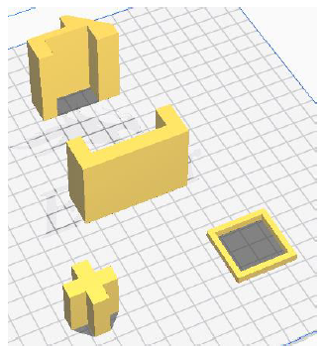
Problem Description
A given set of parts of irregular geometry and small dimension needs to be printed using the Sequential FDM 3D printing process. All dimensions and movements of the printer must be respected, no collisions or superimpositions.
The optimization of the layout of the parts is the main goal of the tool so that the maximum amount of sets of parts can be printed. If two solutions have the same amount of sets, the one that has more parts is the better one;
This type of problem belongs to the Nesting Problems which is a subset of the Cutting and Packing Problems. It is a problem that requires the optimization of a 2D layout with the added difficulty of 3D constraints related to the printer’s movements.
Source: SHAPES (Oliveira, Gomes, & Ferreira, 2000)

Slide 4
Goals
Develop and implement a decision support tool for the positioning of several parts in the printing tray for the process of Sequential FDM.
The tool should:
Present a solution that maximizes the number of sets and parts in the printing tray;
Avoid colisions between the parts and the printer’s head and superimposition of parts;
Graphically output (2D) the printing tray with the layout of the parts;

Slide 5
Overall View of the Problem and Tool
Importing .txt files
Geometric Component
Geometric Representation of the Parts
Combinatory Component
Constructive Heuristic
(Initial Solution)
Tabu Search
(improvement of the initial solution)
Graphical Representation of the Solution

Slide 6
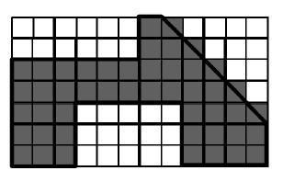
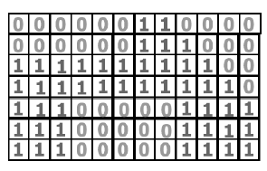
Geometric Representation
The geometric representation of the parts is made through the Raster Method which creates a 2D matrix of 1’s and 0’s according to the part.
1’s represrepresent the part and 0’s represente empty space. A greater resolution allows the part to be represented with more quality but it consumes more memory and is slower to process;
The advantages of this method is that it allows for rapidly check if the layout is feasible (if there is a number greater than 1 there is superimposition). It also allows for the representation of convex, non-convex and complex geometry parts in a relatively easy manner.
Source: Representation of irregular parts proposed by Oliveira and Ferreira (1993)

Slide 7
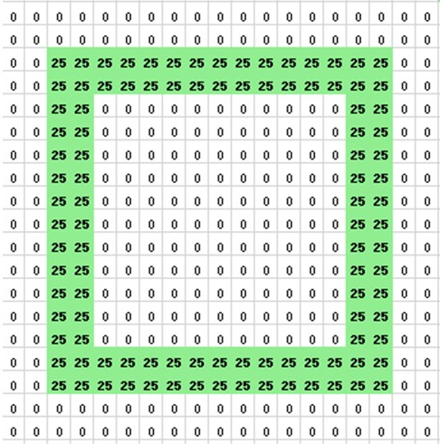
Geometric Representation
In this case, the 1’s that represente the part were replaced for the actual height of the part so that the collisions of the parts with the printer’s head could be checked more easily. It also produces a visual layout with more information as the user can identify the height of each part by looking at the 2D layout.
This process is made through an external app that converts the G-Code of a part into a .txt file developed by a colleague at the Polytechnic Institute of Porto.
Representation of parts implemented in the tool

Slide 8
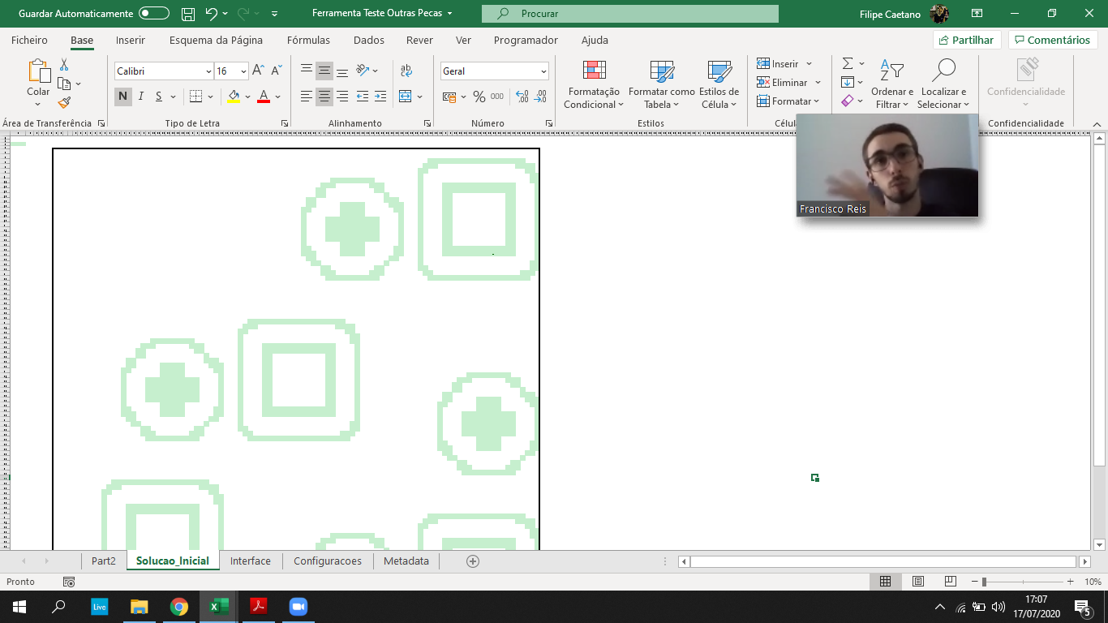
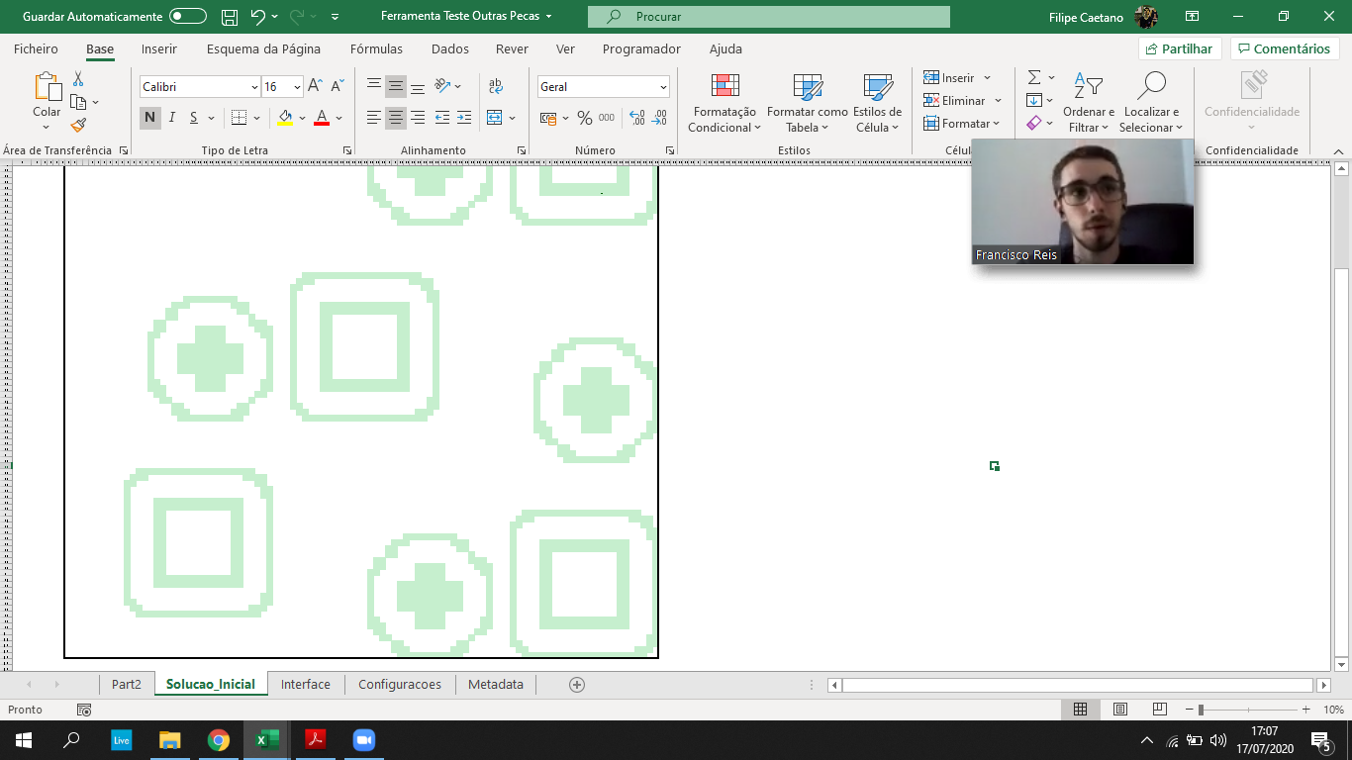
Constructive Heuristic
Allows the creation of an initial solution/layout by selecting and placing each part one by one in the printing tray.
The positioning rule used is bottom-right which means that the parts start being placed in the bottom-right corner.
The sequencing rule is to place the parts by ascending height from the right to the left. When the part does not fit in the current row, it is placed in the row above in the right and the process repeats untill no rows are left;
This approach allows the printer’s moving parts to be mostly behind the parts and avoids some collisions.

Slide 9
Constructive Heuristic - Fluxogram
Gather Height of Parts
Order Heights
If i > num. of parts
Yes
i = 1
Não
Place the i-est smallest part
i = i+1
Yes
If part fits
No
End
Update Layout

Slide 10
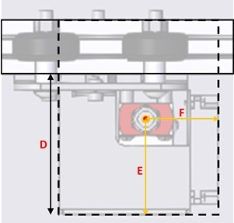
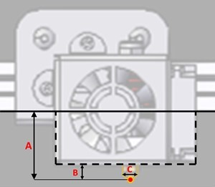
Constructive Heuristic – Mechanical Constraints
A – Arm Height; C – Nozzle Width; E – Nozzle-Head Length;
B – Head Height; D – Head Length; F – Nozzle-Head Width.

Slide 11
Tabu Search
Tabu Search is a meta-heuristic of single solution proposed by Glover in 1986 to optimize complex problems.
Uses past solution to guide the process of future search.
Candidate Solutions
Generate Candidates
Tabu List
List of Forbidden Movements/Solution
Memory
Select Solution
Makes the algorithm accept temporarly solutions that are not better in order to escape local optimal and insert some diversity in the search of solutions.

Slide 12
Tabu Search
Adjacent Pairwise Interchange
Method used to generate neighbours from an initial solution/sequence (S0):
1
2
3
4
5
S0
2
1
3
4
5
S1
S0
1
2
3
4
5
1
3
2
4
5
S2
1
2
4
3
5
S3
1
2
3
5
4
S4

Slide 13
Tabu Search – Pseudo Code
Select Initial Solution x Є X
Initialize Tabu List with size S
While not Stopping Criteria
Select Best x’ Є v(x)
If x’ ∉ Tabu List then
x <- x’
Insert x’ in Tabu List and update it
End
End
Return x
x = best solution
X = possible solution space
S = size of Tabu List
x’ = best local solution
v(x) = set of neighbours of x
Note: Aspiration Criteria was not implemented in this version

Slide 14
Final Tool - Tests
Phase 1 – Validation of the Geometric Representation, Constructive heuristic and Tabu Search:
Simple Parts;
Set with only 2 Parts;

Slide 15
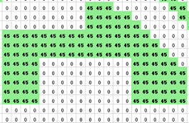
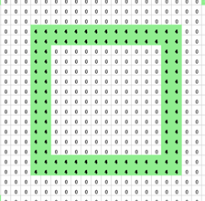
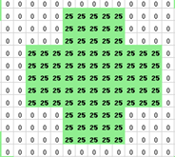
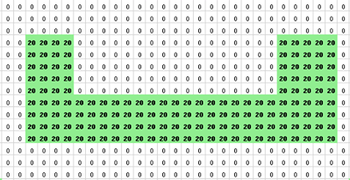
Final Tool - Tests
Fase 2 – Validation of the model with more complex parts;
Set of 4 parts - SHAPES (Oliveira, Gomes, & Ferreira, 2000)
The number of parts in a set and chosen resolution influences the performance of the tool.

Slide 16
Tabu List Size | Stopping Criteria (iterations) | Num of Sets | Num of Parts | Processing Time (s)
5 | 10 | 1 | 8 | 1,5625
 | 50 | 1 | 8 | 3,875
 | 100 | 1 | 8 | 9,941
 | 200 | 1 | 8 | 13,738
10 | 10 | 1 | 8 | 0,988
 | 50 | 1 | 9 | 4,063
 | 100 | 1 | 9 | 8,25
 | 200 | 1 | 9 | 17,808
15 | 10 | 1 | 8 | 1,016
 | 50 | 1 | 9 | 4,19
 | 100 | 1 | 9 | 8,457
 | 200 | 1 | 9 | 17,25
20 | 10 | 1 | 8 | 1,148
 | 50 | 1 | 9 | 4,620
 | 100 | 1 | 9 | 10,214
 | 200 | 1 | 9 | 23,335

Slide 17
Future Works
Conseguir obter as características das peças, da impressão e da impressora através do G-code:
Height, Length and Width of the parts;
Part Quality;
Distance between Part-Skirt;
Skirt Width;
Printer’s Dimensions.
Execute the Rasterization process in the tool without the external app;
Part Rotation in Tabu Search (tha part rotation function is already made).

Slide 18
Conclusions
Develop an intuitive decision support tool that makes the part placing process easy, fast and effective;
Build a personalizable tool (Can add and save custom printers);
Understand the Limitations of the Sequential FDM Process;
Understand the difficulty in the optimization of the printing tray in Addictive Manufacturing.

